Slide 1

Remote Databases
SoftUni Team
Technical Trainers
Software University
https://softuni.bg

Slide 2
Table of Contents
Relational and Non Relational Databases
Backend as a Service - BaaS
Firebase
Using Firebase BaaS

Slide 3
Have a Question?
sli.do #js-advanced

Slide 4



Relational Databases
Represent and store data in tables and rows
Use Structured Querying Language (SQL)
Allows you to link information from different tables through the use of foreign keys (or indexes)

Slide 5

Non Relational Databases
No-SQL databases
More flexibility and adaptability
Allow us to store unstructured data in a single document
Additional processing effort and more storage as the document sizes grow

Slide 6
Relational and Non Relational Pros
Relational
Work with structured data
They support ACID transactional consistency and support "joins"
Built-in data integrity and a large eco-system
Relationships in this system have constraints
Limitless indexing
Non Relational
They scale out horizontally
Work with unstructured and semi-structured data
Schema-free or Schema-on-read options
High availability
Many are open source and so "free"

Slide 7
Backend As a Service
Solutions that provide pre-built, cloud hosted components for developing application backends
Reduce the time and complexity required
Allow developers to focus on core features instead of low level tasks
Types:
Cloud BaaS
Opensource BaaS

Slide 8
Real-Time Cloud DB and App Platform by Google
Firebase

Slide 9
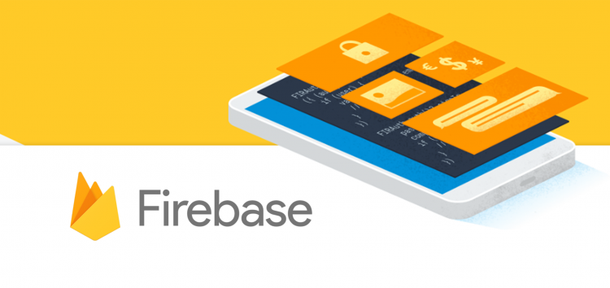
Firebase
Mobile and web development platform. It provides:
Realtime database
Backend as a service
JSON-based data structure

Slide 10
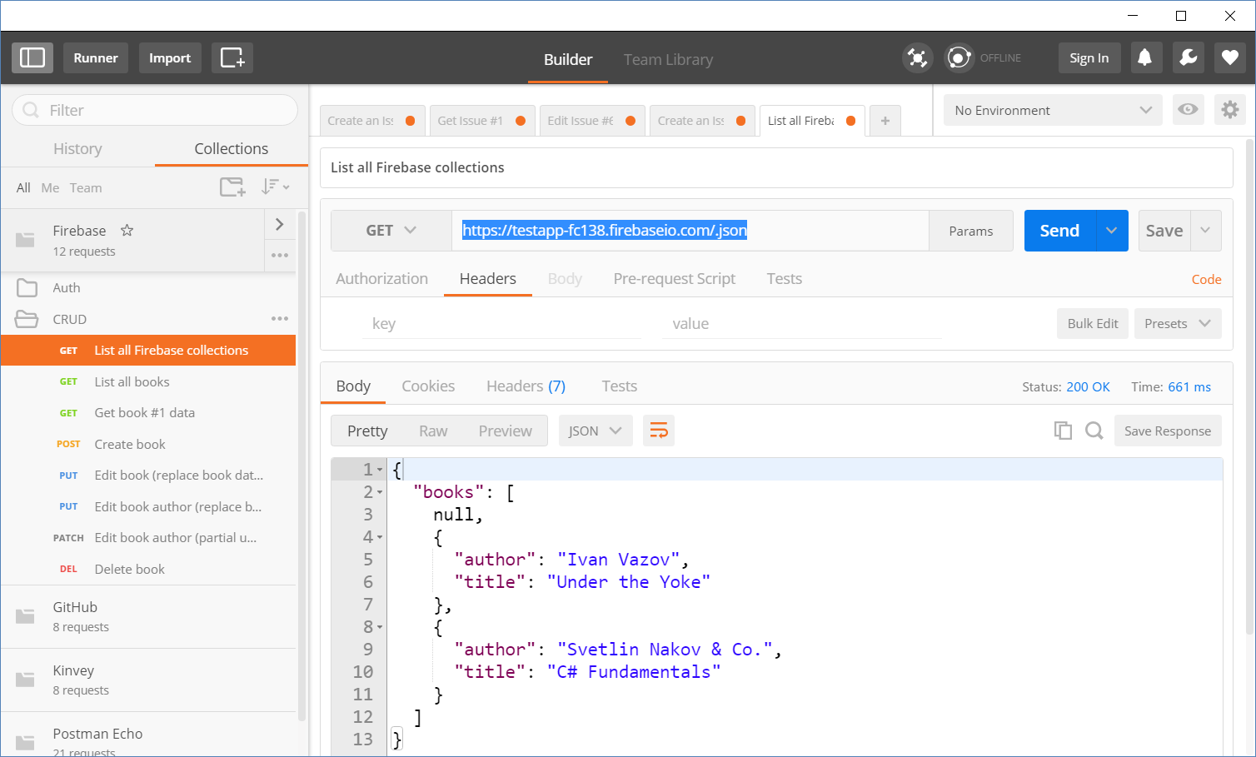
Accessing Firebase REST API with Postman
Append .json to your DB object URL

Slide 11
Firebase REST API – CRUD Operations
GET
https://testapp-fc138.firebaseio.com/.json
GET
https://testapp-fc138.firebaseio.com/books.json
GET
https://testapp-fc138.firebaseio.com/books/1.json
GET
https://testapp-fc138.firebaseio.com/books/1/author.json
POST
https://testapp-fc138.firebaseio.com/books.json
Body
{"title":"New title", "author":"New author"}
DELETE
https://testapp-fc138.firebaseio.com/books/6.json

Slide 12
Firebase REST API – CRUD Operations (2)
PUT
https://testapp-fc138.firebaseio.com/books/7.json
Body
{"title":"Edited", "year":1980, "ISBN":"954X"}
PATCH
https://testapp-fc138.firebaseio.com/books/7.json
Body
{"year":1981, "author":"Author Changed"}
PUT
https://testapp-fc138.firebaseio.com/books/7/author.json
Body
"New author was assigned"
DELETE
https://testapp-fc138.firebaseio.com/books/7/author.json

Slide 13
Authentication vs. Authorization
Authentication
The process of verifying the identity of a user or computer
Questions: "Who are you?", "How you prove it? "
Credentials can be password, smart card, external token, etc.
Authorization
The process of determining what a user is permitted to do on a computer or network
Questions: " What are you allowed to do?", "Can you see this page?"

Slide 14
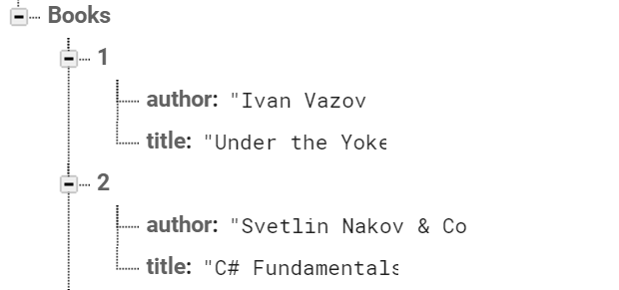

Firebase and Postman: All Books
Open Firebase and create "TestApp" project
Create the following structure
Get all books by AJAX request

Slide 15
Firebase and Postman: Get Book
Using the recently created project in Firebase
Get the book with id: 1
Don't forget the .json extension at the end

Slide 16
Firebase and Postman: Create Book
To create a book in our Firebase project
Send a "POST" request
JSON body should be in the following format:
{
"title":"New title",
"author":"New author"
}

Slide 17

Live Exercises

Slide 18
Summary
…
…
…
Relational Databases
Non Relational Databases
BaaS
Firebase is JSON-based cloud database
(mBaaS) with REST API

Slide 19
Questions?
Notes:
19

Slide 20












SoftUni Diamond Partners

Slide 21




SoftUni Organizational Partners

Slide 22
Trainings @ Software University (SoftUni)
Software University – High-Quality Education, Profession and Job for Software Developers
softuni.bg, softuni.org
Software University Foundation
softuni.foundation
Software University @ Facebook
facebook.com/SoftwareUniversity
Software University Forums
forum.softuni.bg
Notes:
22

Slide 23

License
This course (slides, examples, demos, exercises, homework, documents, videos and other assets) is copyrighted content
Unauthorized copy, reproduction or use is illegal
© SoftUni – https://softuni.org
© Software University – https://softuni.bg
Notes:
23

